Slide 1
How different aspects of Mind-Wandering Predict Intrusive thoughts across various cognitive tasks and whether these predictions differ between Gender
Maya Cohen and Shun Okada

Slide 2
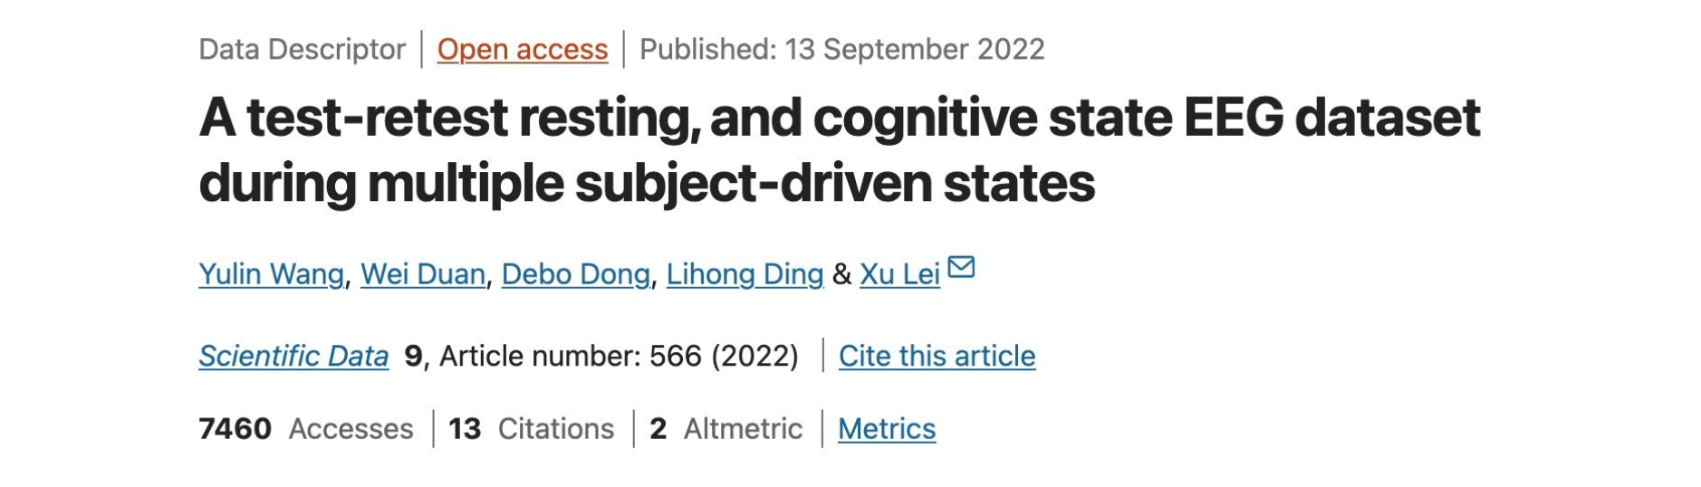
Maya Cohen and Shun Okada

Slide 3
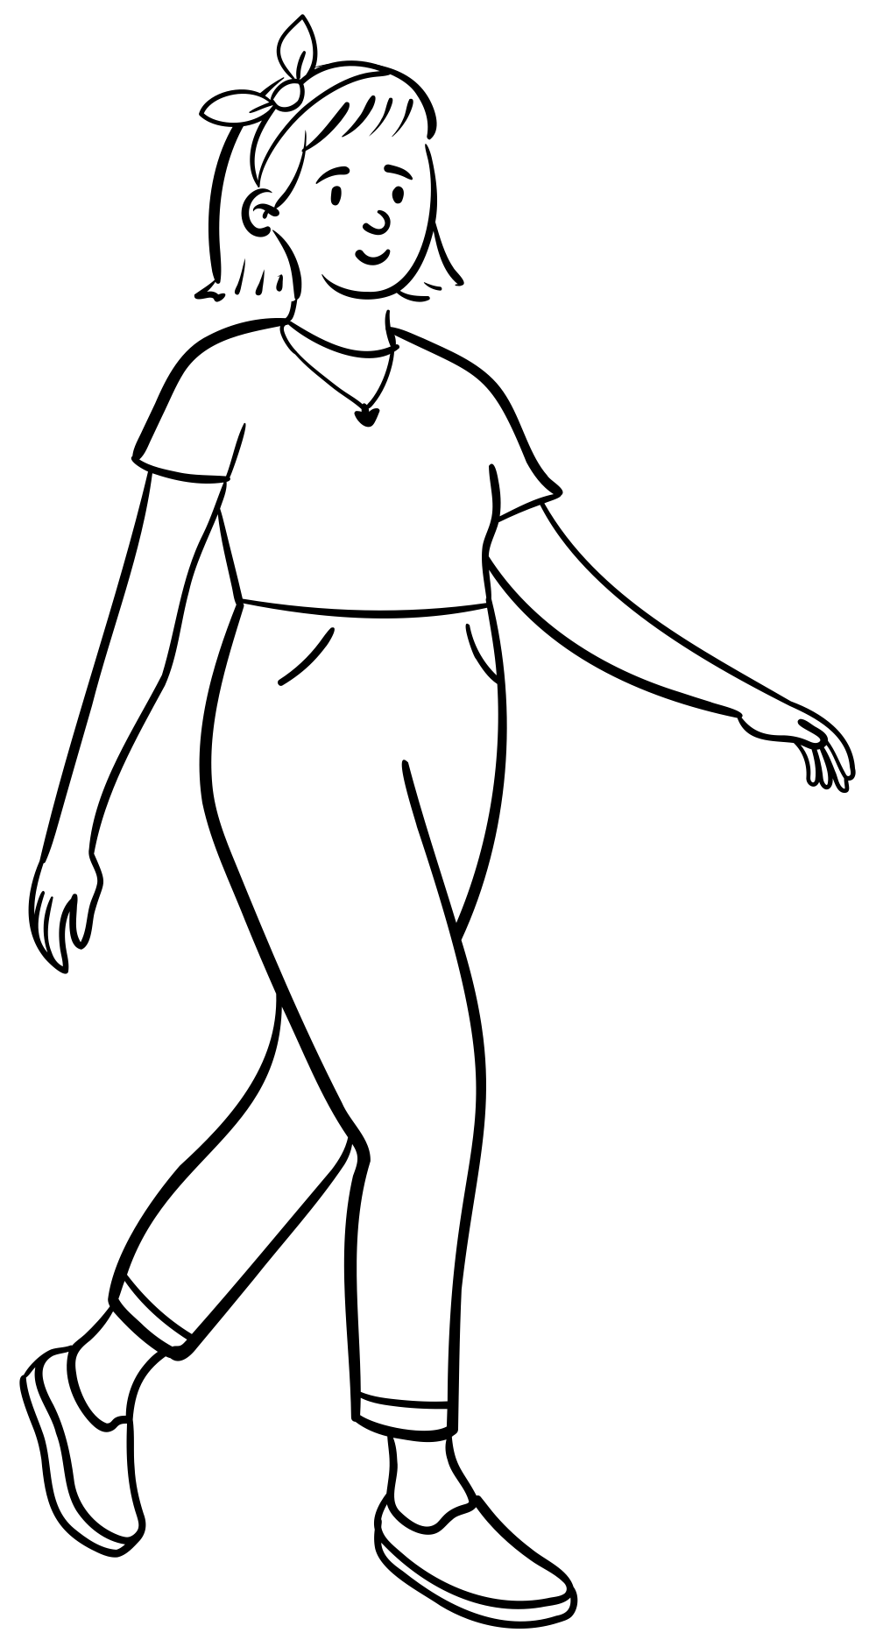




Experiment Flow
EEG Recording while performing cognitive task
ARSQ 2.0 for MW and many others
Randomly executing x1:
EO EC Music
Memory Subtraction
Repeat x5 times
Mini NYC-Q (12 Items) item 12 for IT
End of experiment
Test – retest x3 times

